Slide 1







INSTAGRAM PERFORMANCE ANALYTICS
FOR SUGAR COSMETICS
A data-driven review of engagement, reach, and content performance — with strategic recommendations for the next campaign cycle.
50,000 POSTS • APR 2024 – APR 2025 • TABLEAU DASHBOARD

Slide 2







PROBLEM STATEMENT
Analyze Sugar Cosmetics' Instagram performance and translate the findings into an interactive dashboard that supports strategic social media decisions.
PROJECT
OVERVIEW
THE DECK IS ORGANIZED
Each of the 10 project tasks gets its own slide: one chart, one key insight, and one clear recommendation — so every finding is easy to act on.
OBJECTIVES
Evaluate account performance through engagement and reach
Identify trends in content performance across posts, reels & stories
Determine the best-performing formats, hashtags and posting times
Digital Marketing | Social Media Analytics | Business Intelligence
Understand audience emotion and growth patterns
SUGAR COSMETICS × INSTAGRAM ANALYTICS
1

Slide 3




TASK 1
TWELVE MONTHS OF INSTAGRAM PERFORMANCE
KPI’S OVERVIEW
50,000
147.73M
18.46M
987.42M
18.55%
TOTAL POSTS
TOTAL LIKES
TOTAL COMMENTS
TOTAL REACH
AVG. ENGAGEMENT RATE
KEY INSIGHT
An 18.55% engagement rate on nearly a billion in reach is a strong, healthy number — the account isn't relying on a few viral spikes, it's earning consistent interaction across all 50,000 posts.
RECOMMENDATION
Use this baseline (18.55%) as the benchmark for every future campaign. Anything posting meaningfully below it needs review, any clearing it is worth repeating.
SUGAR COSMETICS × INSTAGRAM ANALYTICS
2

Slide 4
TASK 2
MONTHLY POSTING TREND
Posting Has Stayed Remarkably Consistent
KEY INSIGHT
Posting volume remained consistent at 4.1K-4.3K posts/month.
Drops in Apr'24 and Apr'25 are due to partial-month data, not reduced activity.
No major spikes or declines in posting frequency throughout the year.
Higher posting volume did not lead to higher engagement.
RECOMMENDATION
Maintain the current posting cadence.
Focus on content quality over quantity.
Invest in creative formats, stronger messaging, and campaign optimization.
Track and optimize for engagement metrics, not just posting volume.
SUGAR COSMETICS × INSTAGRAM ANALYTICS
3

Slide 5
TASK 3
TOP 10 POSTS BY LIKES
What Content Gets the Most Likes ?
KEY INSIGHT
No single format dominates the top 10 by likes — the highest and lowest posts differ by just 3% (11,043–11,392 likes).
Reels and Images each take 3 of the top 10 spots, the strongest showing among all formats.
Video and Story each appear twice, performing competitively despite fewer top-10 appearances.
The spread across all 10 posts is tiny — only ~350 likes separate the #1 post from the #10 post.
Overall, raw-likes performance is evenly spread across formats, not concentrated in one.
RECOMMENDATION
Prioritize a balanced content mix — no format needs deprioritizing based on raw likes.
Double down on creative quality, since it matters more than format choice at this tight margin.
Keep testing Reels and Images, which show a slight edge in top-10 representation.
Don't sideline Video or Story — both hold their own among the top performers.
SUGAR COSMETICS × INSTAGRAM ANALYTICS
4

Slide 6
TASK 4
TOP 10 POSTS BY ENGAGEMENT RATE
Which Posts Convert Reach Best ?
KEY INSIGHT
Image posts achieve the highest engagement rate (34.1%), narrowly ahead of Reels and Stories.
Video is the most frequent top-10 performer, appearing 4 times — more than any other format.
All formats are tightly clustered between 33.8% and 34.1% — a very narrow spread.
No single format dominates; performance differences between the top 10 are minor.
RECOMMENDATION
Maintain a balanced content mix — no format is dramatically ahead of the others.
Video shows the most consistent top-tier presence (4 of the top 10), so it remains worth continued investment.
Images can also drive top-tier engagement, don't deprioritize them.
Since the gap between formats is under 0.3%, focus on content quality and creative execution rather than format alone.
SUGAR COSMETICS × INSTAGRAM ANALYTICS
5

Slide 7
TASK 5
POST TYPE PERFORMANCE COMPARISON
Every Format Performs Within a Tight Band
KEY INSIGHT
All content formats perform at a very similar level, with only small differences in average likes, comments, and saves.
Stories have the highest average engagement, but the lead over other formats is minimal.
Reels, Videos, and Images perform nearly on par with Stories, indicating no clear "best" format overall.
The data suggests that content quality matters more than content format.
RECOMMENDATION
Maintain a balanced mix of Images, Reels, Stories, and Videos.​‌
Focus on improving content quality and relevance, as format alone is not driving significant performance differences.​‌
Select formats based on campaign objectives (reach, engagement, education, or product awareness).​‌
Continue testing different content types, as each format has the potential to perform well.
SUGAR COSMETICS × INSTAGRAM ANALYTICS
6

Slide 8
TASK 6
DAY OF WEEK ANALYSIS
Posting Day Barely Moves the Needle
KEY INSIGHT
Engagement rates are nearly identical across all days of the week, ranging from approximately 18.4% to 18.6%.
Wednesday has the highest engagement rate, but only marginally above other days.
Sunday has the lowest engagement rate, though the difference is negligible.
The gap between the best and worst day is less than 0.3 percentage points, indicating no meaningful "best day" to post.
Audience engagement appears consistent throughout the week.
RECOMMENDATION
Do not optimize content strategy around a specific day of the week.
Schedule posts based on campaign timing, content readiness, and business priorities.
Focus on content quality and format, as these are likely to have a greater impact than posting day.
Maintain a consistent posting schedule across the week.
SUGAR COSMETICS × INSTAGRAM ANALYTICS
7

Slide 9
TASK 7
ENGAGEMENT FUNNEL
A Healthy Drop-Off — No Leaks in the Funnel
KEY INSIGHT
Impressions (1.28B) generated strong Reach (987.4M),
with 77% of impressions converting to reach.
Likes (147.7M) are the largest engagement action, showing strong audience interaction once content is seen.
Comments (18.5M) are significantly lower than Likes, which is a normal engagement pattern.
Saves (8.9M) slightly outperform Shares (8.1M), suggesting audiences are more likely to save content for later than share it with others.
No unusual drop-offs are visible in the funnel; engagement decreases gradually at each stage.
1.28B
IMPRESSIONS
987.4M
REACH
147.7M
LIKES
18.5M
COMMENTS
RECOMMENDATION
8.1M
SHARES
Maintain current reach-driving strategies, as content distribution is performing well.
Focus on increasing Shares and Saves, which are the smallest engagement actions in the funnel.
Create more how-to, educational, and value-driven content that users are likely to save or share.
Add stronger "Save this" and "Share with a friend" CTAs to drive deeper engagement.
8.9M
SAVES
SUGAR COSMETICS × INSTAGRAM ANALYTICS
8

Slide 10
TASK 8
HASHTAG ANALYSIS
Hashtag Choice Barely Moves the Needle Either
KEY INSIGHT
All Five hashtags perform at a similar engagement rate (18.5%-18.7%).
#BoldLooks delivers the highest engagement rate (18.7%), but the lead is minimal.
#SugarCosmetics has the lowest engagement rate (18.5%), though the gap is not significant.
No hashtag consistently outperforms the others by a meaningful margin.
The current hashtag set appears to be delivering similar audience engagement outcomes.
RECOMMENDATION
Continue using a mix of existing hashtags rather than relying on a single "best" hashtag.
Test new niche and category-specific hashtags to identify opportunities for incremental reach and engagement.
Focus more on content quality and creative execution, as hashtag selection appears to have limited impact on engagement.
Refresh hashtag combinations periodically to avoid over-reliance on the same set.
SUGAR COSMETICS × INSTAGRAM ANALYTICS
9

Slide 11
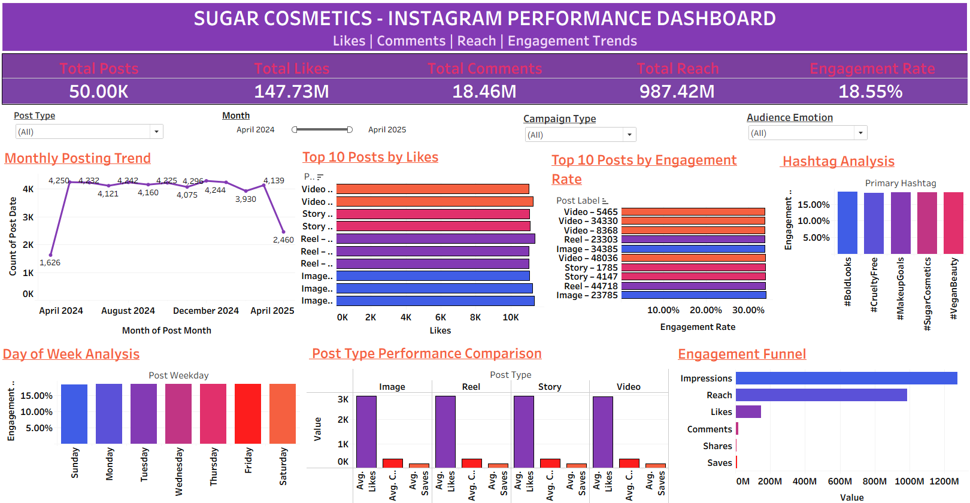
TASK 9
FINAL DASHBOARD
One Interactive View of Everything Above
Live in Tableau Public — filterable by Post Type, Month, Campaign Type & Audience Emotion
SUGAR COSMETICS × INSTAGRAM ANALYTICS
10

Slide 12

KEY TAKEAWAY · INSIGHT + ACTION
The account is consistent everywhere except where it counts. Sharpen the content format mix,
and then fix the funnel's weakest stage — Shares & Saves.
50,000
18.55%
987.42M
77%
TOTAL POSTS
AVG. ENGAGEMENT RATE
TOTAL REACH
IMPRESSIONS → REACH
01
Consistency is the account's strength
50,000 posts over 12 months, steady at 4,100–4,300/month, driving an 18.55% engagement rate across 987M reach.
→ Keep this cadence as the campaign benchmark — don't chase volume.
02
No single format dominates engagement or likes
Top 10 by likes is a near-tie across formats (11,043–11,392, <3% spread); Video appears most in the Top 10 by engagement rate (4 of 10), all clustered 33.8–34.1%.
→ Don't over-index on format — focus on creative quality, and lean on Video where sustained engagement rate matters most.
03
Timing, hashtags & format barely move the needle
Day (18.42–18.63%), hashtags (18.52–18.67%) and format (2,941–2,964 avg. likes) all sit within a 1% band.
→ Redirect effort to content quality, not scheduling or tags.
04
Funnel is healthy, but Shares & Saves lag
77% of 1.28B impressions convert to reach (987M) — but Shares (8.1M) and Saves (8.9M) are the smallest stage.
→ Build save-worthy, shareable hooks into every content brief.
Bottom line: Focus next quarter on content quality and campaign type — not timing, hashtags, or format alone. Use the dashboard as the weekly source of truth.
SUGAR COSMETICS × INSTAGRAM ANALYTICS
11

Slide 13
THANK YOU
Questions & discussion welcome.
Full interactive dashboard available on Tableau Public
Dataset sugar_cosmetics_instagram_data (50,000 posts, Apr 2024–Apr 2025)

